Slide 1

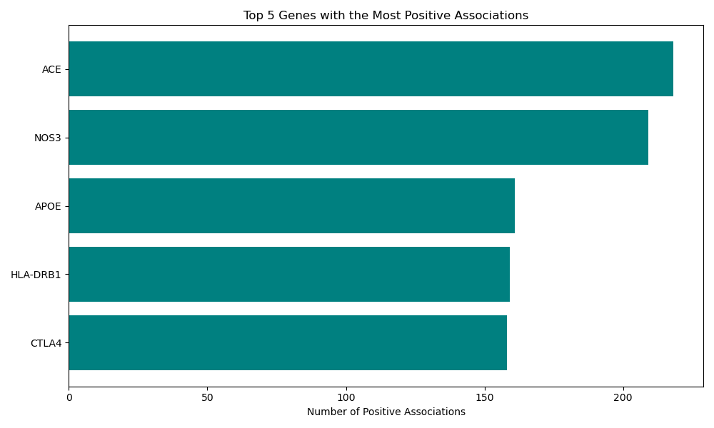
Genes and Positive Association Janav Sama, Student Northeastern University
Research Question: What are the top 5 genes that have a large number of positive associations?
Figure 1: SQL Query Executed
Figure 2: Bar chart representing output
The bar chart highlights the top five genes with the highest number of positive disease associations. ACE and NOS3, which
are primarily linked to cardiovascular diseases, show the most associations. APOE, ranks third, showing its pivotal role in neurodegenerative conditions. HLA-DRB1 and CTLA4, essential in immune regulation, demonstrate significant associations with autoimmune diseases. Understanding the frequency of their positive associations can help prioritize future research into potential treatments, particularly for conditions where these genes play a critical role.
Citation: Becker et al. (2004). The Genetic Association Database. Nature Genetics, 36(5):431-2.

